Slide 1
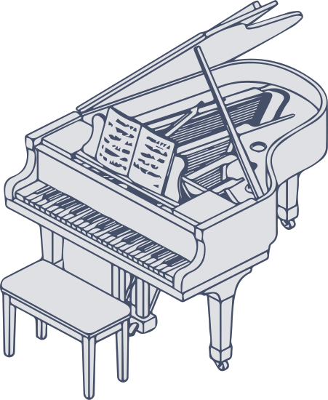
Huge mess among musical instruments
English oral presentation
Ethan Bernon
Notes:
Hello everyone, I’m Ethan Bernon and I will present some facts about music theory and musical instruments that irritate me. I call this presentation: “Huge mess among musical instruments”.
To understand this presentation, I need to explain how notes work. I will use a piano keyboard, because I’m used to it and I think it’s easier to understand than other instruments.

Slide 2
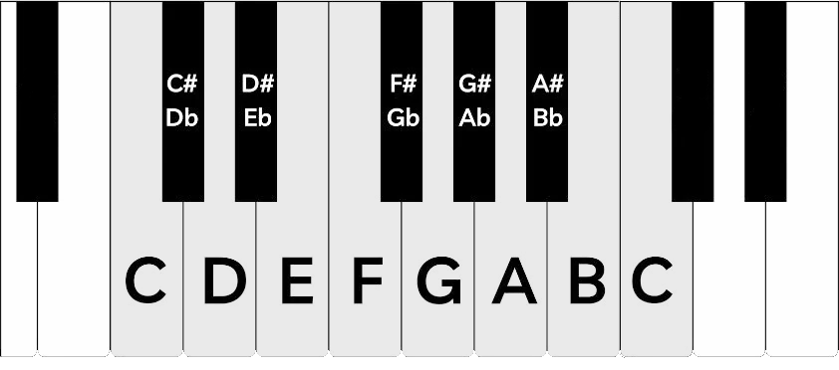
Piano keyboard layout
Notes:
Here you can see the layout of a piano keyboard.
Notes are named with letters from A to G, and the names loop.
That’s why there are two C’s, but they don’t have the same pitch : the one on the left is lower than the one on the right.
Notes on the white keys are called natural notes, and notes on the black keys are altered notes.
There are two main alterations: the sharp and the flat.
The sharp raises the pitch and the flat lowers it. So a single note can have two names, and this is called enharmonic equivalence.
Now that you know more about notes, I can show you the first problem.

Slide 3
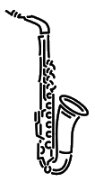

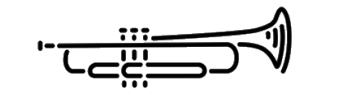
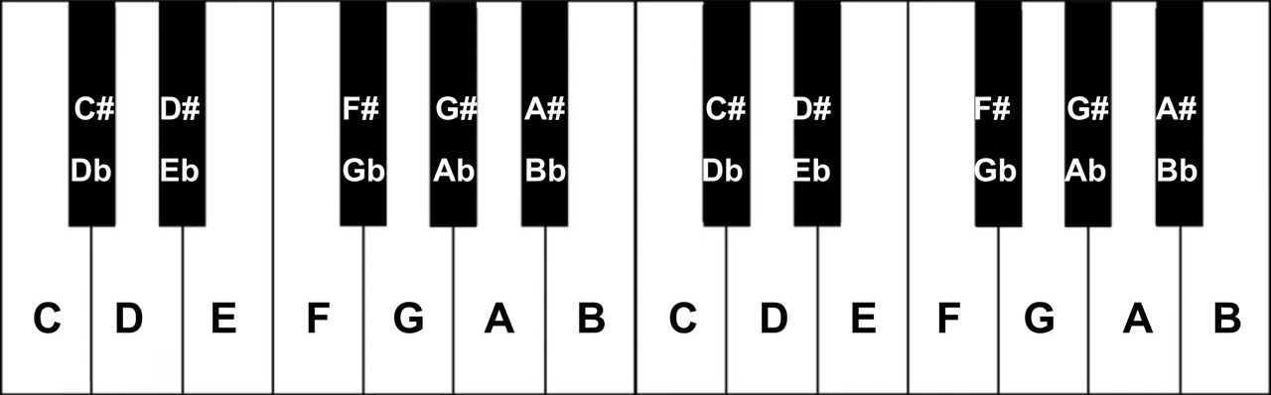
Transposing Instruments
Alto saxophone
Trumpet
Eb Clarinet
Notes:
Transposing instruments.
Transposing instruments are instruments whose notes don’t sound the way they are written.
For example, when I press the C key on a piano, I hear a C, right ? However, with an alto saxophone, when I play what is written as a C, I hear an E flat. That’s strange, isn’t it ?
Some instruments read the same notes but produce different sounds. That’s the whole problem. And as a pianist, playing with a saxophonist can be very difficult because of that.
There are multiple transposing instruments such as Trumpet, Clarinet and others…
But the piano is not as perfect as you might think.

Slide 4
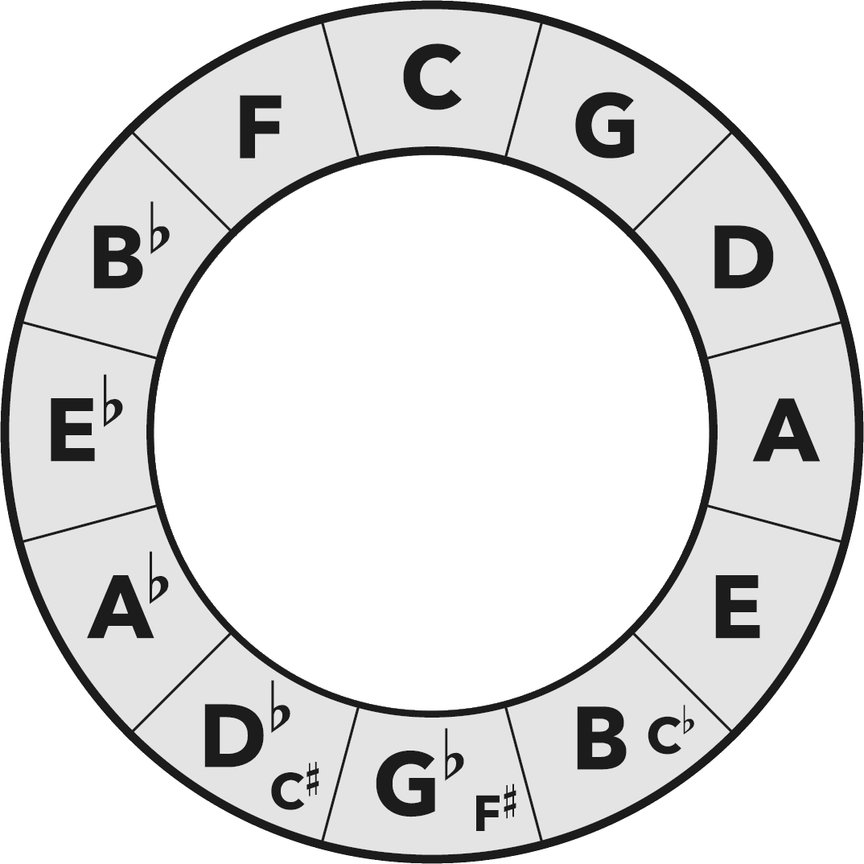

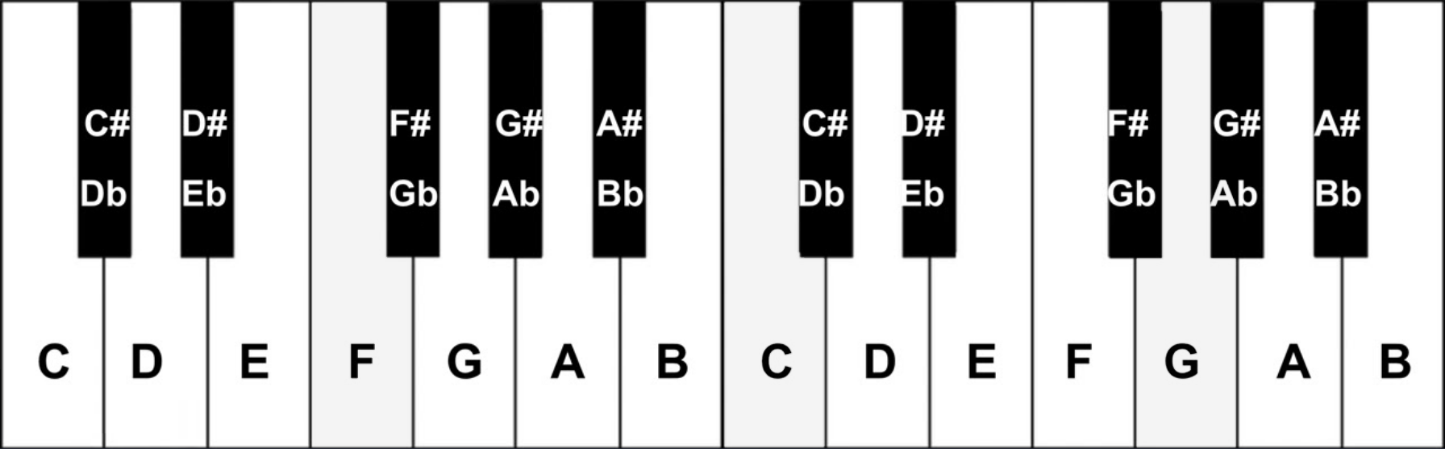
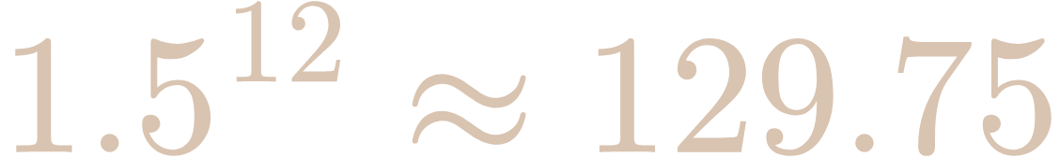
Circle of fifths
x1.5
x1.5
Notes:
Let me introduce the circle of fifths. To build it, you start from a note, for example C, and you go up by a fixed interval called a fifth. C, G, D, A, and so on. After twelve steps, you have been through all twelve notes, and you should be back on C.
But here is the catch. Notes are frequency and go up a fifth is equivalent to multiply the frequency by 1.5. If you stack twelve pure fifths, you don’t land exactly on C : you end up slightly too high, by about a quarter of a semitone.
Here this number should be equal to 128. So you can see that there is a gap and this gap is called the Pythagorean comma

Slide 5
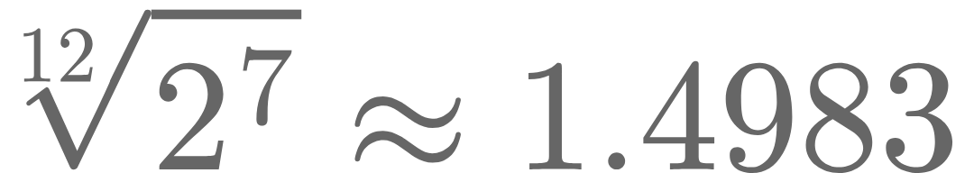
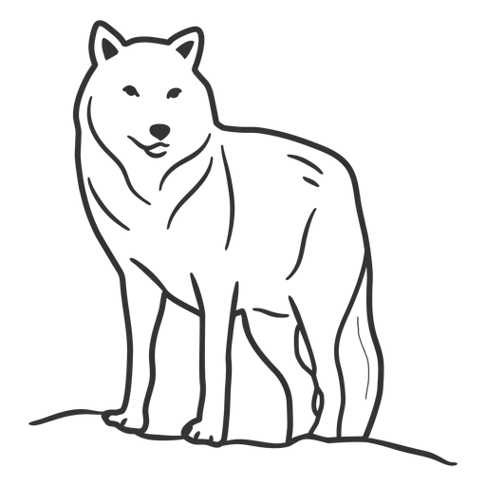
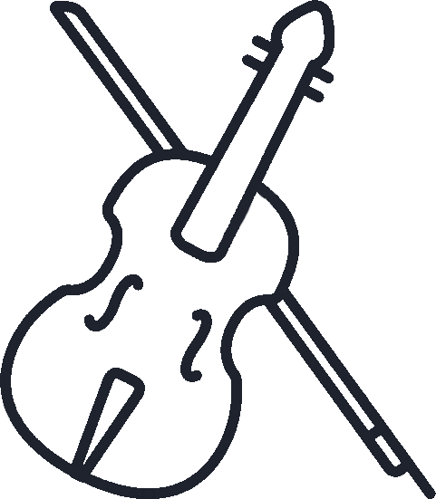
Wolf fifth
Notes:
The piano “solves” the problem by cheating: every fifth multiply by 1.4983 instead of 1.5. This specific fifth is called a wolf fifth.
The result is that almost no interval on a piano is perfectly in tune.
Whereas string instrument like violin do not have this issue because they don’t are tied to a button or a key to play notes, they can place their fingers everywhere on the string.
And that is why I say it’s a huge mess in my opinion.

Slide 6
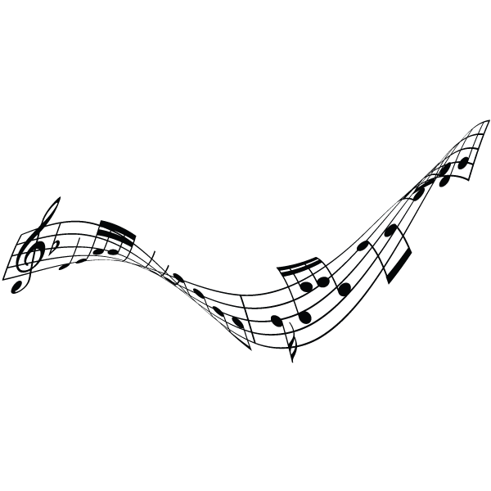
Thank you for your attention

